Slide 1
Medical domain-adapted stable diffusion model for the generation of realistic chest X-ray images
ECE 285
Zhaowei Zhang | Jane 2, 2025

Slide 2
Project Objectives
To fine-tune a text-conditional latent diffusion model (LDM) to synthesize high-fidelity chest X-ray images controlled by domain-specific text prompts.
To evaluate the quality, diversity, and realism of the generated synthetic images using established evaluation metrics such as FID (Fréchet Inception Distance) and IS (Inception Score).
By achieving these objectives, this project aims to demonstrate the feasibility and value of domain-adapted generative models in addressing data scarcity and accelerating AI development in medical imaging.

Slide 3
Project Background
Medical image is a field where access to well-annotated and diverse datasets is often restricted due to need for expert radiological interpretation, stringent privacy regulations, and data isolation across healthcare institutions.
Developing robust machine learning models in the field is hampered by limited data availability, particularly for rare pathologies or nuanced clinical presentations. This scarcity poses a significant barrier to training and evaluating reliable AI systems for clinical deployment

Slide 4
Project Background
Latent diffusion models (LDMs) generate high-fidelity images and are valuable in data-scarce domains, but off-the-shelf models trained on natural images often struggle with the specialized language and unique visuals of medical imagery.
By fine-tuning diffusion models with medical data and text, we can generate synthetic images that enrich datasets for rare and underrepresented cases, enhancing model robustness and overcoming data scarcity in a safe, efficient, and scalable way in medical AI.

Slide 5
Method
Model Architecture:
This project utilizes the Latent Diffusion Model (LDM) Stable Diffusion 1.5 (SD1.5) as the foundational generative architecture. The SD pipeline consists of three main components:
Variational Autoencoder (VAE)
Denoising U-Net Backbone
Text Conditioning via CLIP

Slide 6
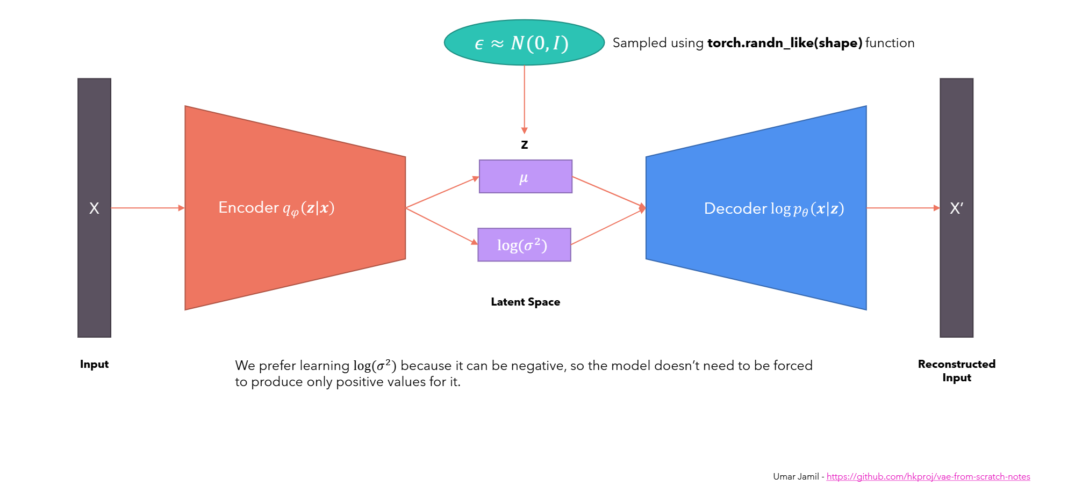
Method
Variational Autoencoder (VAE):
Notes:
The SD pipeline uses a pre trained VAE. It compresses high- dimensional image inputs into a lower-dimensional latent space and reconstructs images from these representations during decoding.

Slide 7
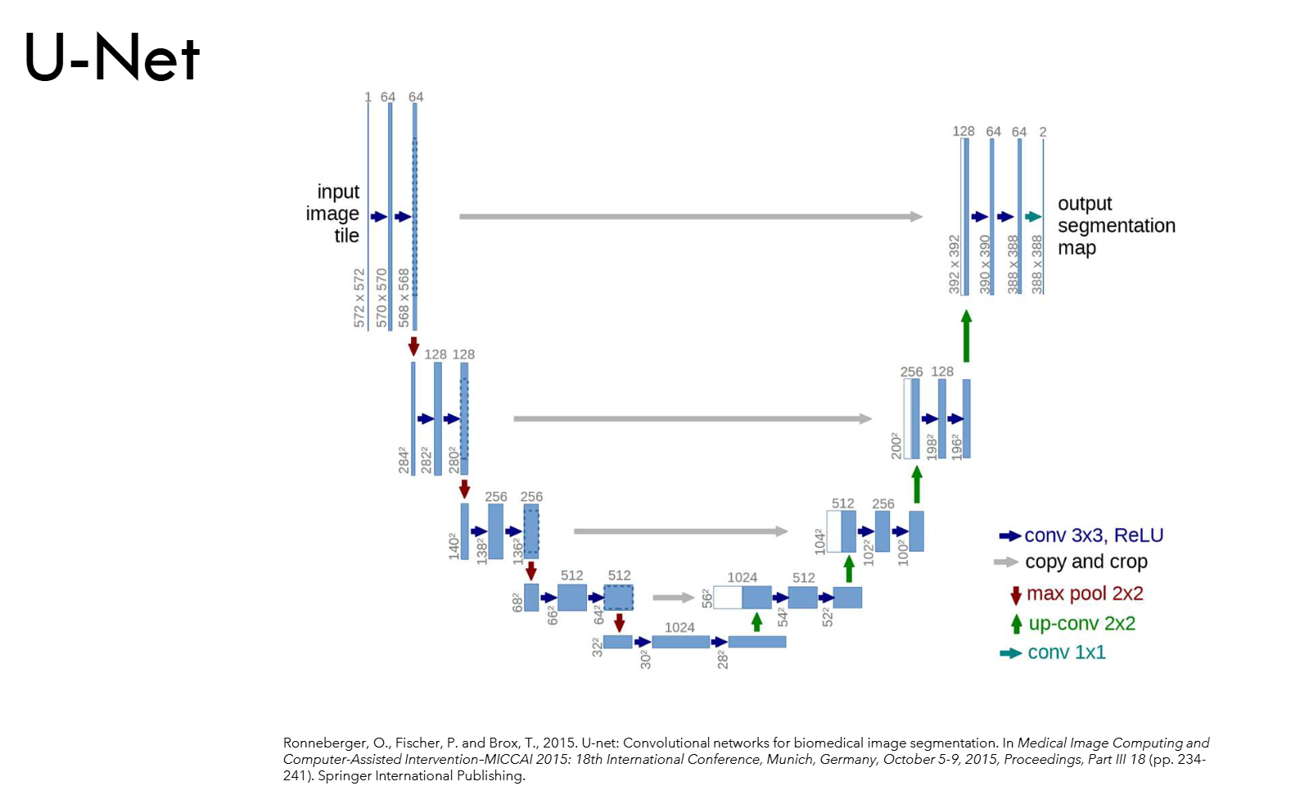
Method
Denoising U-Net Backbone:
Notes:
The core denoising model is a U-Net structure that is composed of down-scaling layers followed by up-scaling layers, it has residual blocks handling latent images and time embedding and cross-attention blocks(x,condition) that allows the model to condition its denoising process on text embeddings from a text encoder.

Slide 8
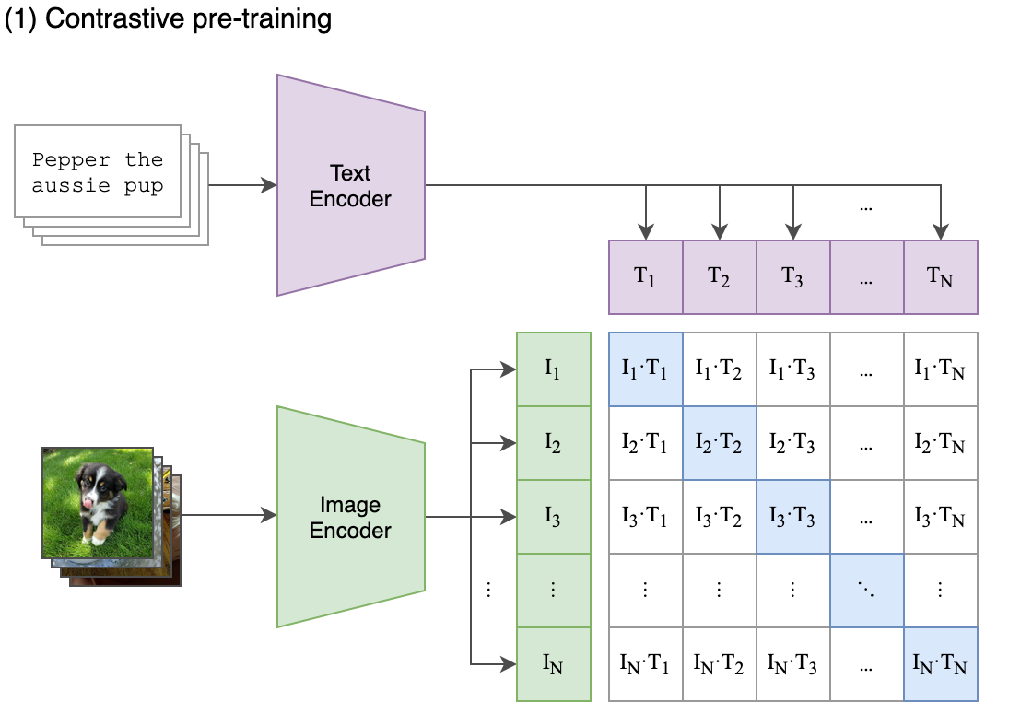
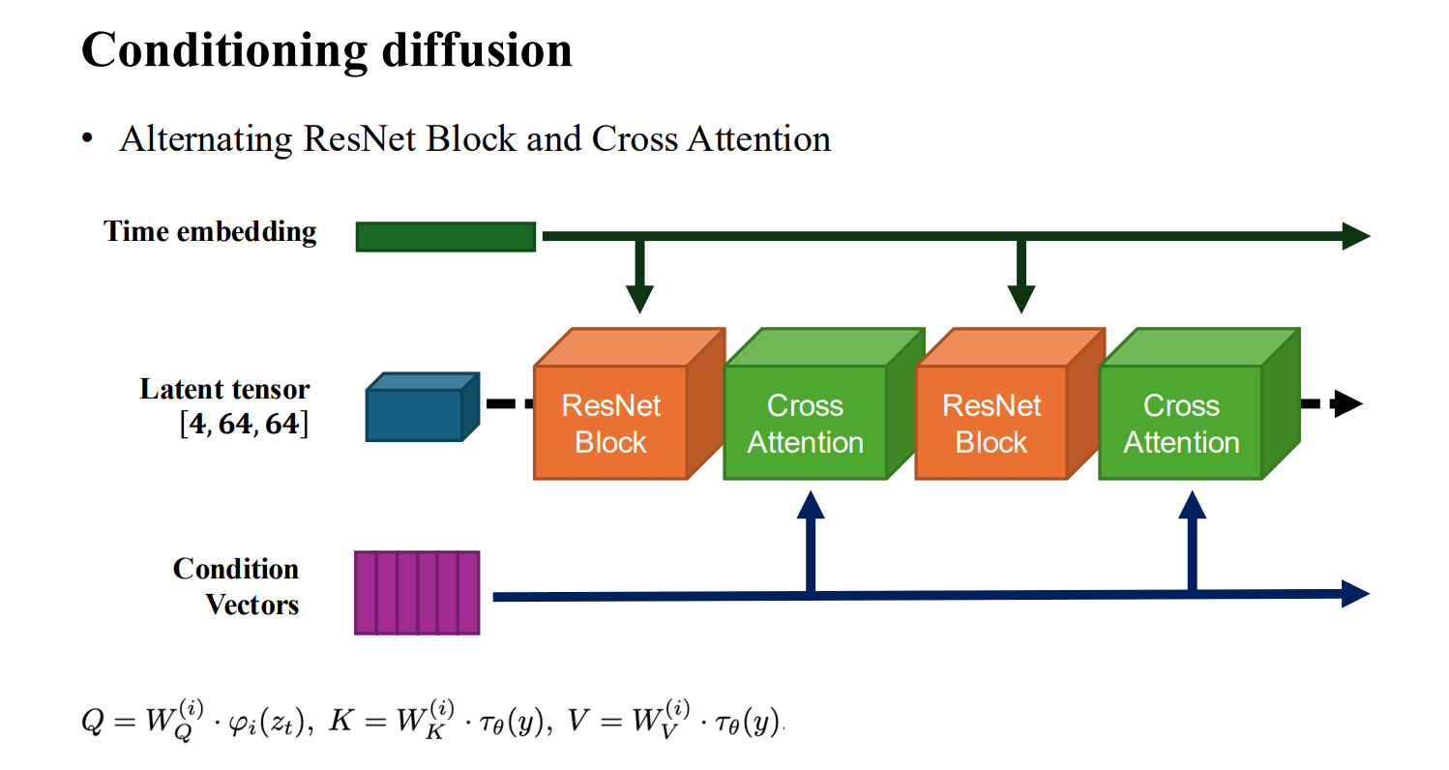
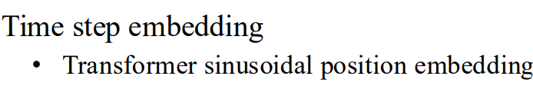
Method
Text Conditioning via CLIP:
Notes:
The conditioning mechanism employs a pre-trained CLIP ViT-L/14 text encoder, which encodes input prompts into a 768-dimensional embedding vector. Each text input is limited to a maximum of 77 tokens

Slide 9
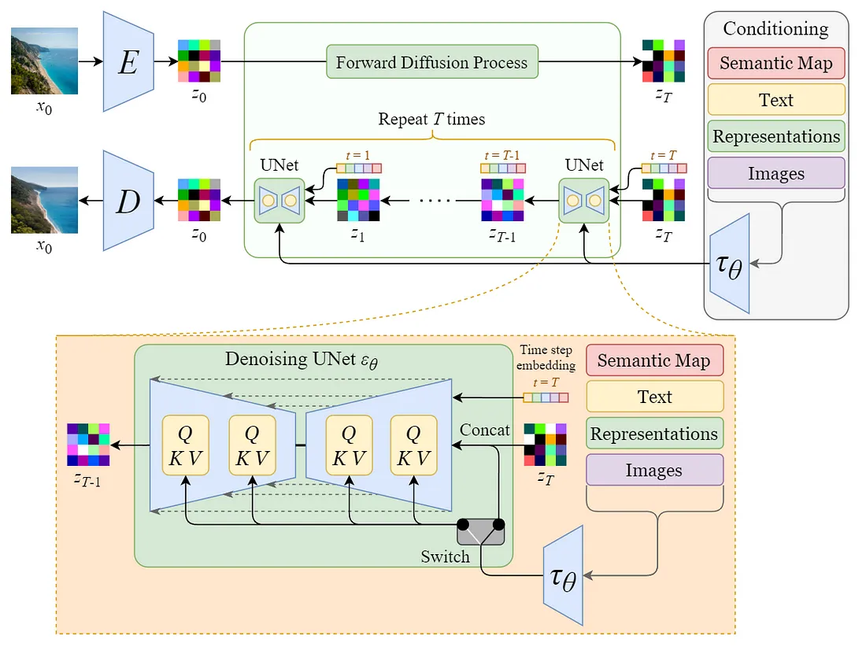
Method
Stable Diffusion Pepline:
Notes:
To generate an image, the process begins with a latent vector sampled from Gaussian noise. This
vector is denoised through multiple iterations using the U-Net, where cross-attention integrates
semantic information from the CLIP text encoder at various layers. The final denoised latent vector is
then passed through the VAE decoder to reconstruct a high-resolution image in pixel space.

Slide 10
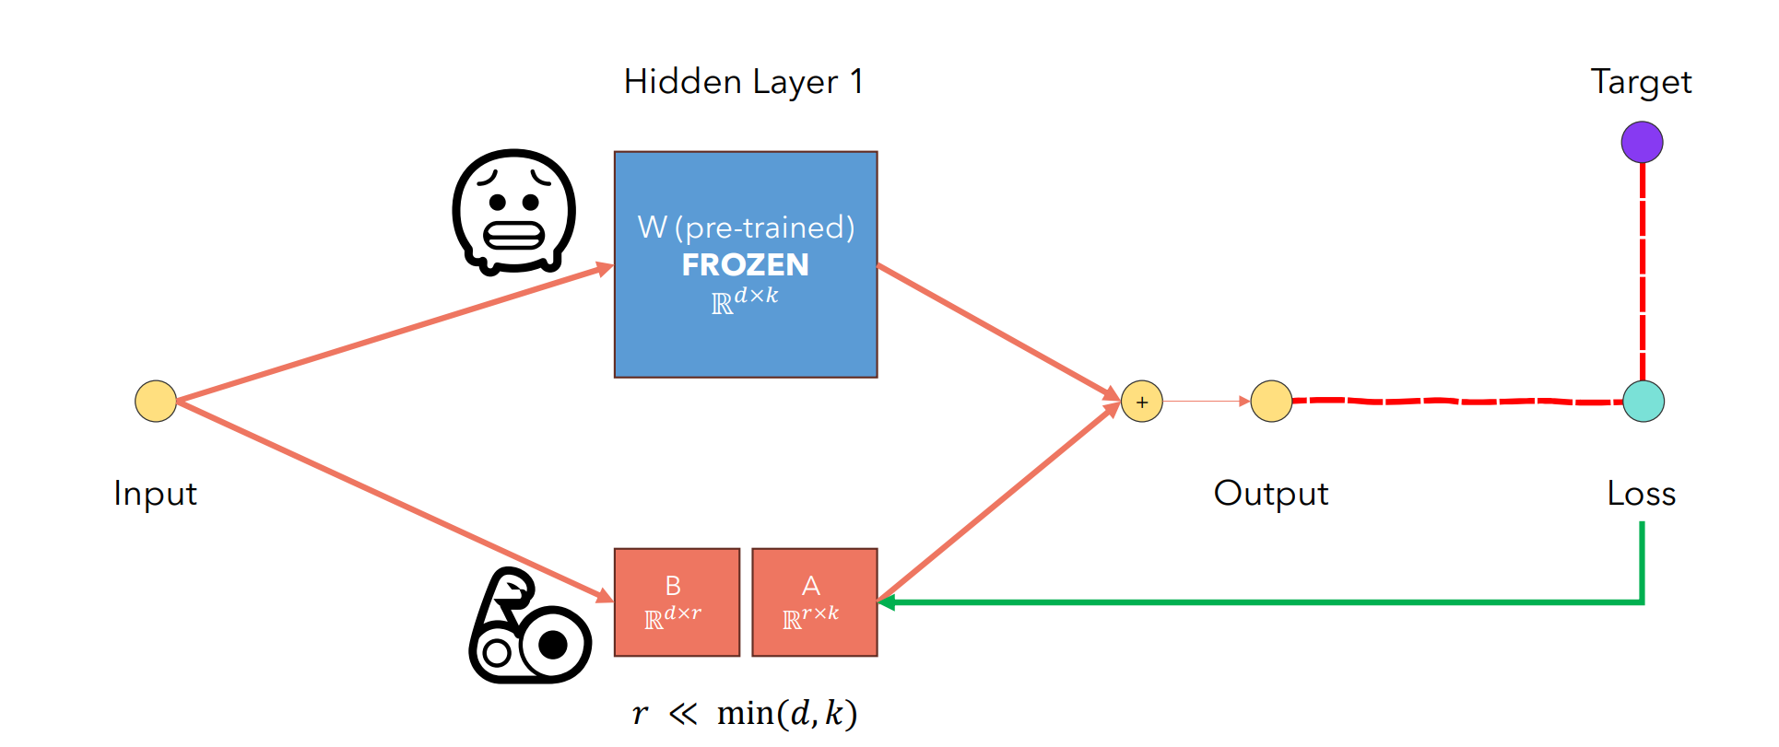
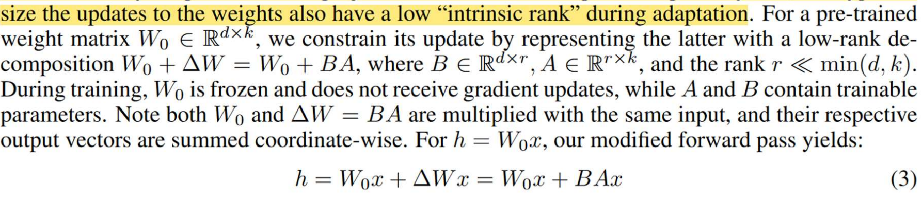
Method
Low-Rank Adaptation (LoRA)
Notes:
Low-Rank Adaptation (LoRA) is a parameter-efficient fine-tuning technique designed for large pre-trained models. Instead of updating all model weights during fine-tuning, LoRA injects trainable low-rank matrices into specific layers—typically the linear projections in attention modules—while keeping the original weights frozen. This significantly reduces the number of trainable parameters, leading to faster training and lower memory usage, without sacrificing performance.

Slide 11
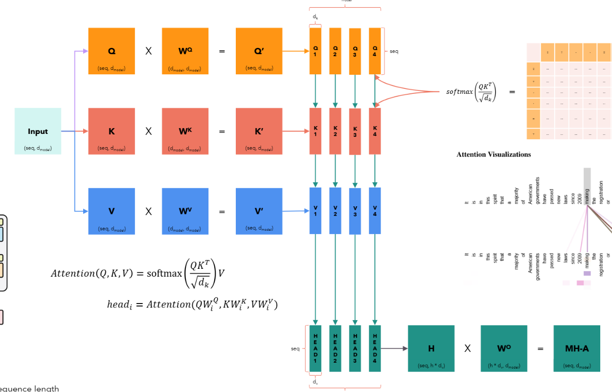
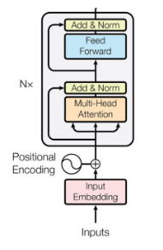
Method
Low-Rank Adaptation (LoRA)

Slide 12
Method
Dataset: Chest X-rays (Indiana University) from Kaggle
Image Data:
A public chest x-ray dataset of 7466 chest X-ray images of different views(Frontal and Lateral) and corresponding reports from 3851 patients
Due to Memory limitation, Images got resized to resolution of 128
Text prompt:
Used the impression section, a summary section of a radiology report focused on the relevant findings and their interpretation, excluding empty samples and those exceeding the CLIP tokenizer’s maximum length of 77 tokens (total of 102 cases, 2.65% of all cases).
Eventually got 7281 unique image-text pairs for fine tuning experiment
Training set: 5825 pairs, 80% Test set: 1456 pairs, 20%

Slide 13
Fine-tuning Experiment
Fine-tuning experiment was conducted on a NVIDIA P100 GPU offered by kaggle.
LoRA-based fine-tuning was applied exclusively to the U-Net component of the Stable Diffusion model using chest X-rays (CXRs) at a resolution of 128 × 128 pixels and a batch size of 4, while all other components were kept frozen.
Model weights for the Stable Diffusion pipeline (version 1.5) were obtained from the repository stable-diffusion-v1-5/stable-diffusion-v1-5 on the Hugging Face Hub. The implementation is based on the diffusers library (version 0.32.2) and the official LoRA training framework provided by Hugging Face.

Slide 14
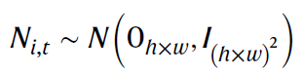
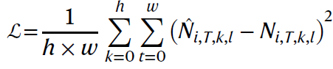
Fine-tuning Experiment
For each pair i and timestep t, random Gaussian noise Ni,t gets sampled in the latent space of dimensions (h, w), This Gaussian noise is added to the latent representation of ypixel.
The U-Net ψ processes the noisy latent representation EV (ypixel) ⨁TNi,t and encoded prompt ET (xtext) to predict the last added noise Nî ,T
A mean squared error loss computed between the true and predicted noises Ni,t and Nî ,T enables to compute gradients and update the weights of the unfrozen components.
Notes:
Fine-tuning on CXR-report pairs was achieved by predicting the noise component of noisy latent image representations, calculating the mean squared error between sampled and predicted noise, backpropagating and updating unfrozen SD pipeline components.

Slide 15
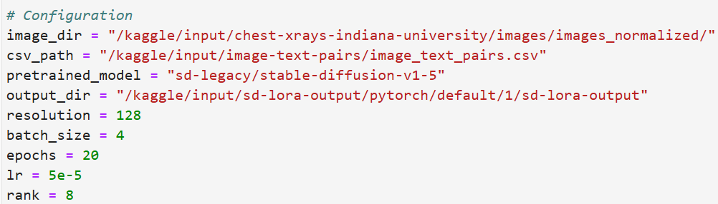
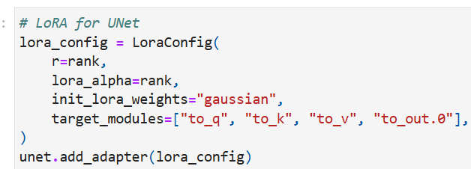
Results
Hyperparameter settings:

Slide 16
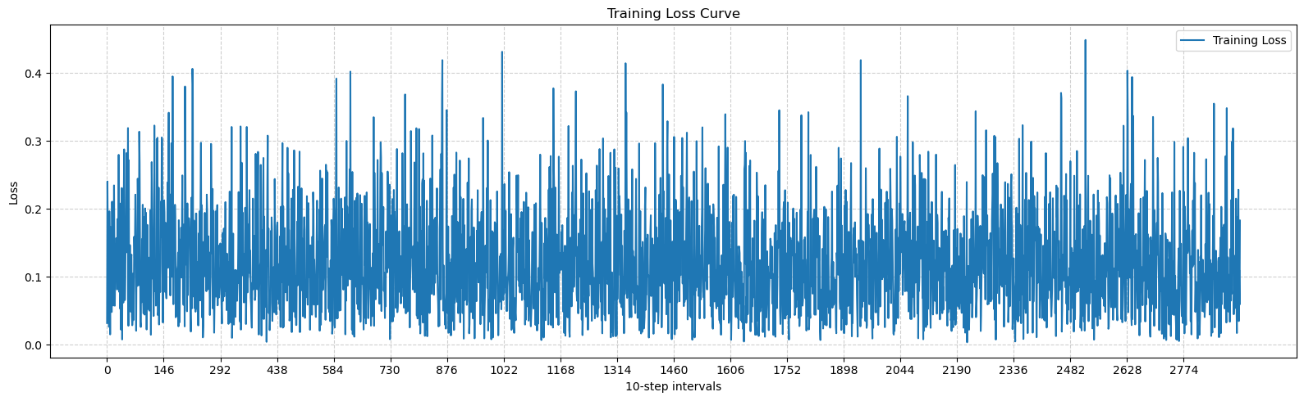
Results
Training loss curve:
Notes:
The curve exhibits noticeable oscillations, which are typical for diffusion model training. Despite the high variance, the trainingloss remains bounded within a reasonable range (approximately 0.0 to 0.4), and no signs of instabilityor divergence are observed throughout the training process.Such fluctuations are common in denoising diffusion models, where the loss is computed betweenpredicted and sampled noise components at randomly selected timesteps. Additionally, the use ofLoRA introduces lightweight updates to select layers (e.g., attention projections in U-Net), whichmay lead to slower but more stable convergence patterns.Overall, the training dynamics suggest that the model successfully learned from the paired CXR-reportdata, while maintaining training stability under the low-rank adaptation constraints.s

Slide 17
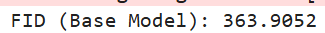
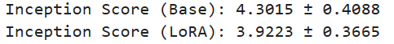
Results
Fréchet inception distance:
Inception distance:

Slide 18
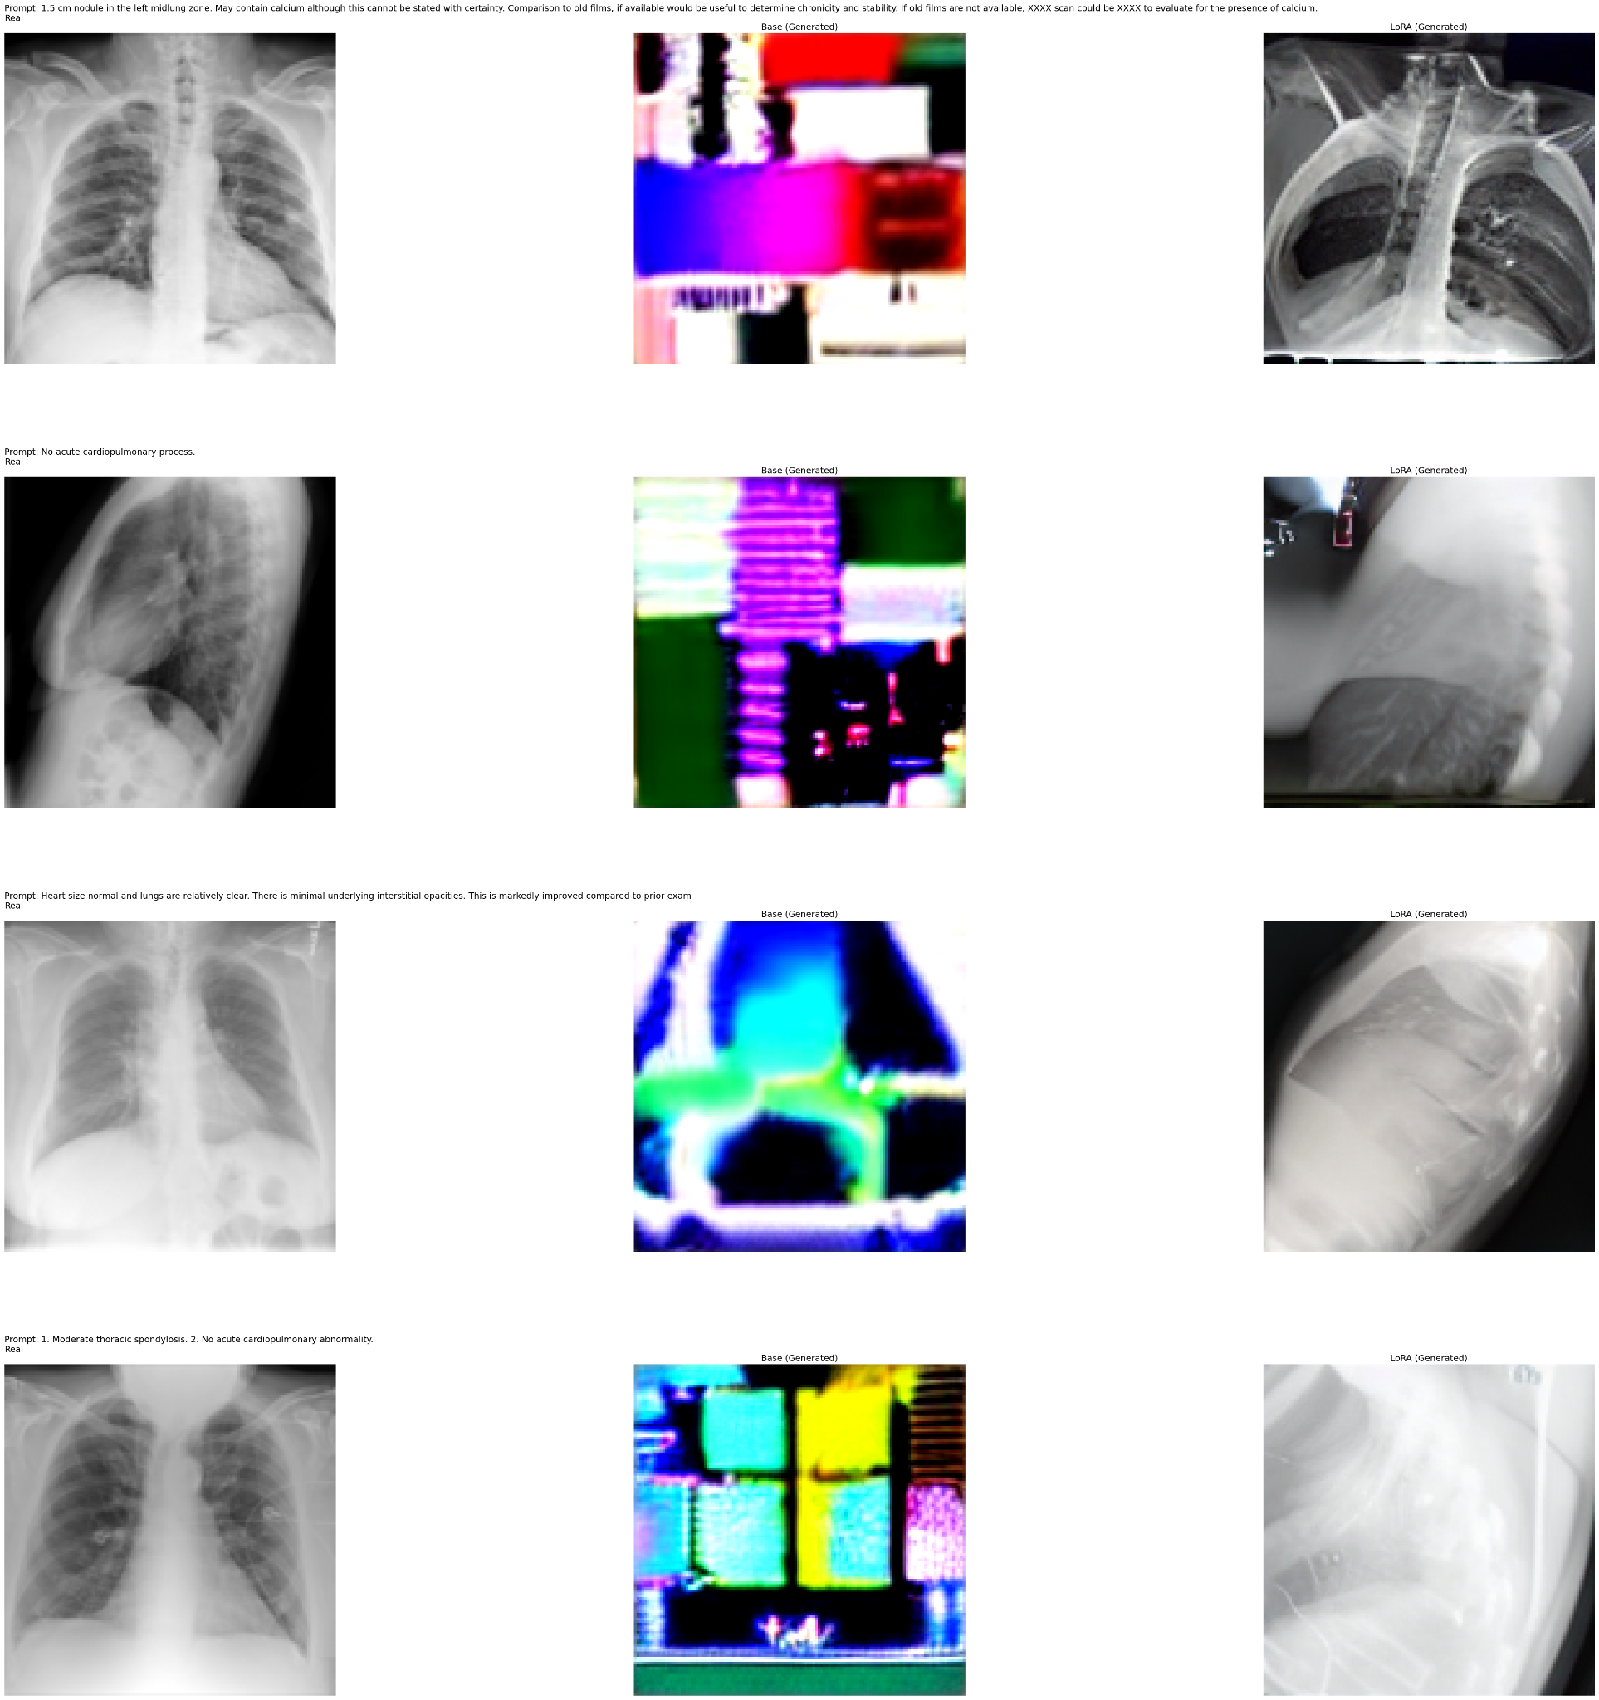
Results
Image comparison(128 x 128):
Notes:
Both the base and LoRA models struggle to maintain structural and anatomical
realism, and the outputs often lack meaningful spatial organization. This can be attributed to the
limited representational capacity at low resolutions, as well as the challenge of modeling fine-grained
anatomical details using such compressed spatial dimensions.

Slide 19
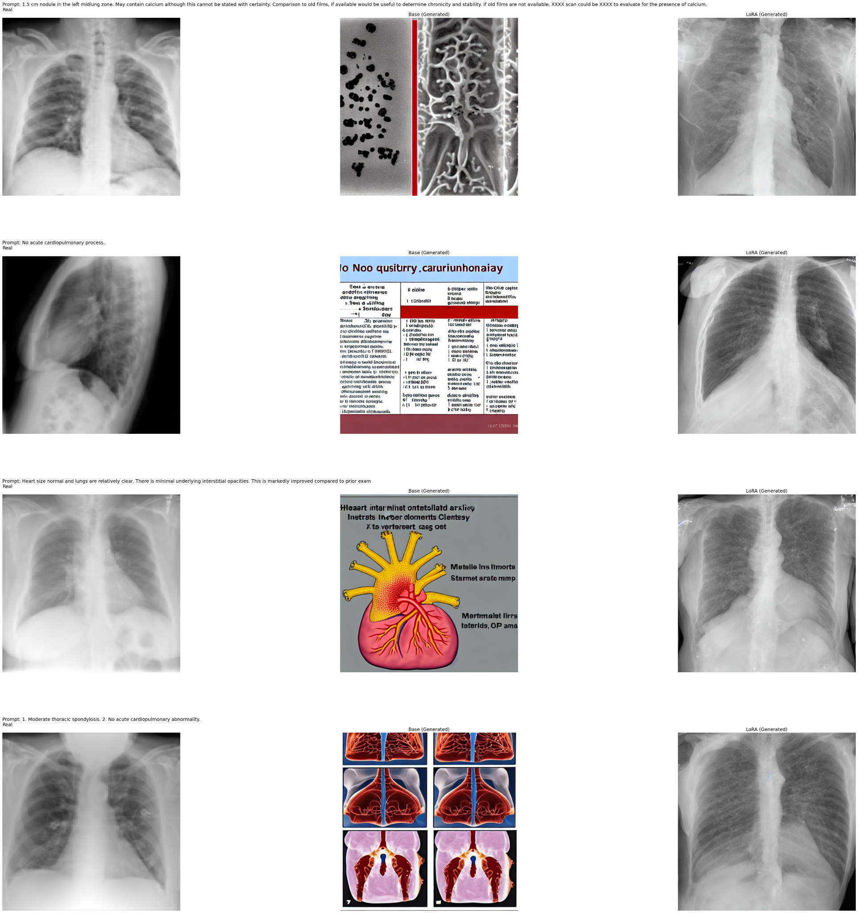
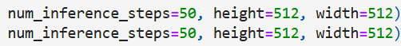
Results
Image comparison(512 x 512):
Notes:
exhibit a dramatic improvement in visual fidelity. The
LoRA-finetuned model generates outputs that closely resemble real CXRs in texture, anatomy, and
orientation. Compared to the base model at this resolution, the LoRA-enhanced images show better
alignment with the semantic content of the input reports and avoid the artifacts and incoherent patterns
that frequently appear in the base model’s outputs.

